Slide 1
Compton Effect

Slide 2
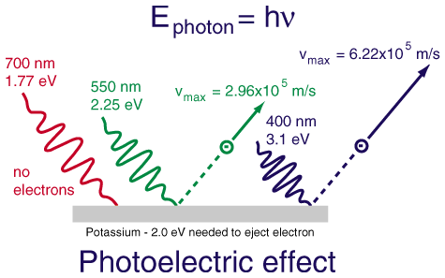

Slide 3
The scattering of photons from charged particles is called Compton scattering after Arthur Compton who was the first to measure photon-electron scattering in 1922. When the incoming photon gives part of its energy to the electron, then the scattered photon has lower energy and according to the Plank relationship has lower frequency and longer wavelength. The wavelength change in such scattering depends only upon the angle of scattering for a given target particle.

Slide 4
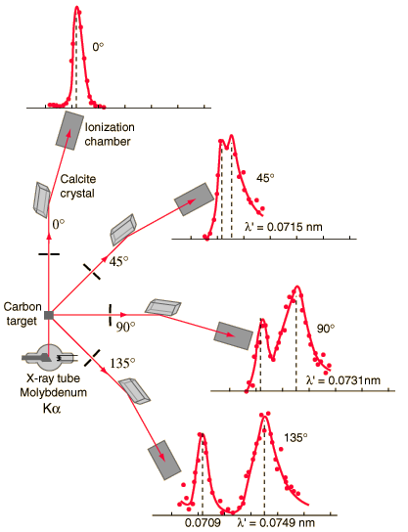

Slide 5


Slide 6
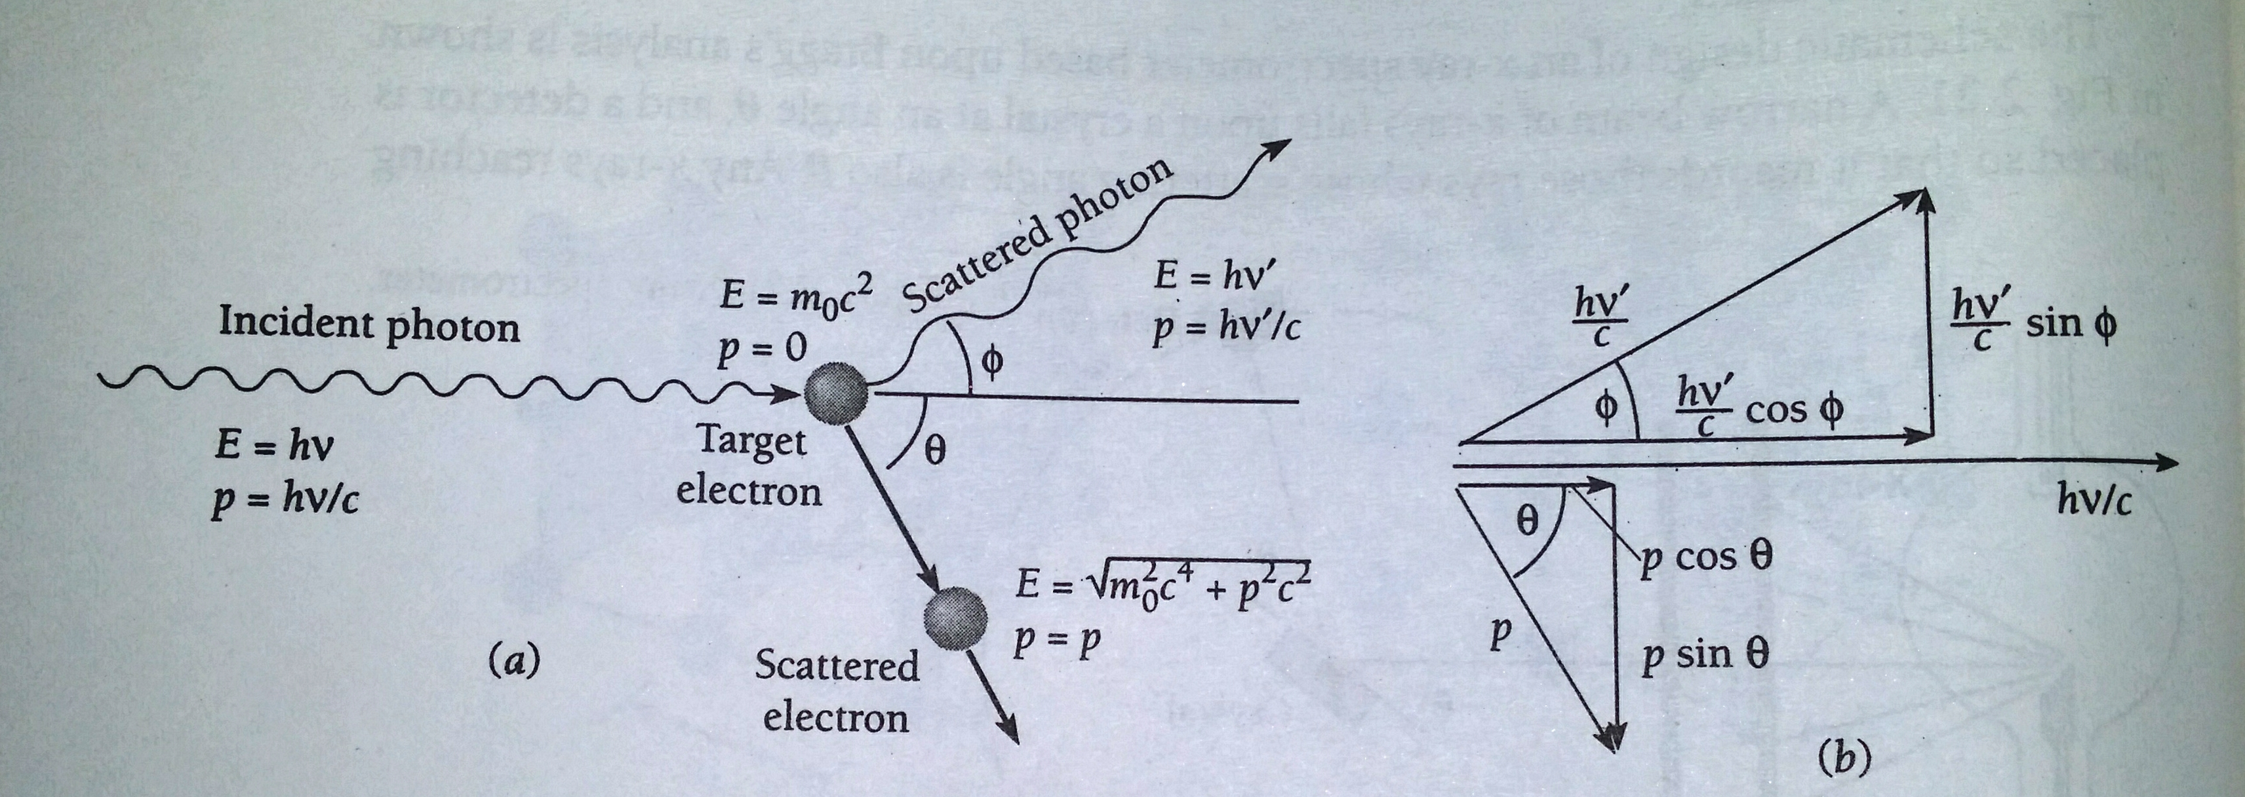

Slide 7
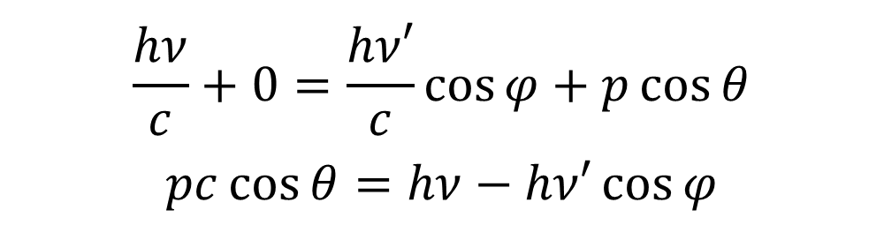
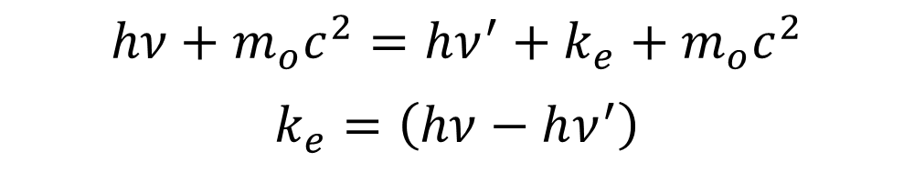
According to law of conservation of energy
Thus ………(1)
According to law of conservation of momentum along x-axis
Thus ……………(2)
$$hν+m_{o}c^{2}=hν^{′}+k_{e}+m_{o}c^{2}$$
$$k_{e}=\left(hν−hν^{′}\right)$$
$$\frac{hν}{c}+0=\frac{hν′}{c}\cos{φ}+p\cos{θ}$$
$$pc\cos{θ}=hν−hν′\cos{φ}$$

Slide 8
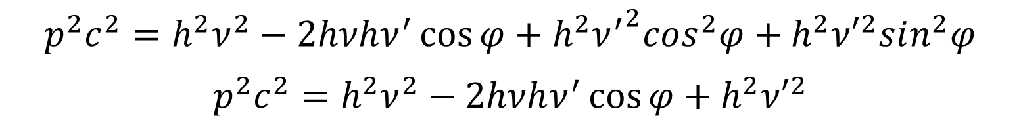
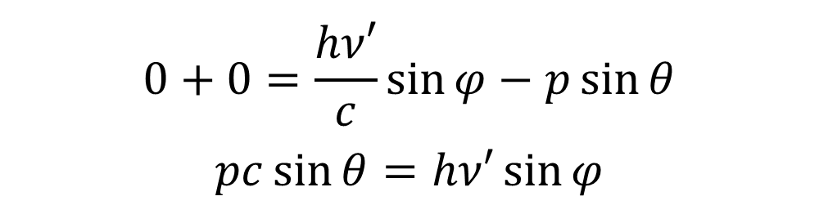
According to law of conservation of momentum along y-axis
Thus ………….(3)
Squaring equation (2) & (3) and adding them we get
…………(4)
$$0+0=\frac{hν′}{c}\sin{φ}−p\sin{θ}$$
$$pc\sin{θ}=hν′\sin{φ}$$
$$p^{2}c^{2}=h^{2}ν^{2}−2hνhν^{′}\cos{φ}+h^{2}{ν^{′}}^{2}cos^{2}φ+h^{2}{ν′}^{2}sin^{2}φ$$
$$p^{2}c^{2}=h^{2}ν^{2}−2hνhν^{′}\cos{φ}+h^{2}{ν′}^{2}$$

Slide 9

By relativistic formula we know that total energy of any particle = KE + rest mass energy
…..(5)
$$E=k_{e}+m_{o}c^{2}=\sqrt{p^{2}c^{2}+m_{o}^{2}c^{4}}$$
$${(k_{e}+m_{o}c^{2})}^{2}=p^{2}c^{2}+m_{o}^{2}c^{4}$$
$$k_{e}^{2}+2k_{e}m_{o}c^{2}+m_{o}^{2}c^{4}=p^{2}c^{2}+m_{o}^{2}c^{4}$$
$$p^{2}c^{2}=k_{e}^{2}+2m_{o}c^{2}k_{e}$$
$$p^{2}c^{2}={(hν−hν^{′})}^{2}+2m_{o}c^{2}(hν−hν^{′})$$
$$p^{2}c^{2}=h^{2}ν^{2}−2hνhν^{′}+h^{2}{ν^{′}}^{2}+2h(ν−ν^{′})m_{o}c^{2}$$

Slide 10

Equating equation (4)&(5), we get
$$\left(ν−ν^{′}\right)m_{o}c^{2}−hνν^{′}=−hνν′\cos{φ}$$
$$\left(ν−ν^{′}\right)m_{o}c^{2}=hνν^{′}−hνν^{′}\cos{φ}$$
$$\left(ν−ν^{′}\right)m_{o}c^{2}=hνν′(1−\cos{φ})$$
$$\left(ν−ν^{′}\right)=\frac{hνν^{′}}{m_{o}c^{2}}(1−\cos{φ})$$
$$\frac{ν−ν′}{νν′}=\frac{h}{m_{o}c^{2}}(1−\cos{φ})$$

Slide 11

Compton Shift
$$\frac{1}{ν′}−\frac{1}{ν}=\frac{h}{m_{o}c^{2}}(1−\cos{φ})$$
$$\frac{λ^{′}}{c}−\frac{λ}{c}=\frac{h}{m_{o}c^{2}}\left(1−\cos{φ}\right)$$
$$\left(λ^{′}−λ\right)=\frac{h}{m_{o}c}(1−\cos{φ})$$
$$Δλ=\frac{h}{m_{o}c}(1−\cos{φ})$$

Slide 12
Compton received Physics Noble Prize for this in 1927

Slide 13

Compton Wavelength
= 2.426 x 10⁻¹² m
= 2.426 pm
= 0.024 Å

Slide 14

Compton Effect not observed for visible light
The change in wavelength due to Compton effect is given by:
= 0.024 Å
The maximum value of is 2 when ϕ = 180°, so that the maximum wavelength change possible is 0.048 Å or roughly 0.05Å only.

Slide 15
This means that Compton effect can be detected only for those radiations whose wavelength is not greater than a few Å. For example, for λ=5Å, there is a maximum wavelength-change of 1%, while for λ=1Å there is a 5% change. For visible light (λ≈5000Å) the maximum wavelength change (0.05Å) is only about 0.001% of the initial wavelength which is undetectable.

Slide 16

Kinetic energy of Scattered (recoil) electron:
From Eq. (1) we know that
$$k_{e}=h(ν−ν^{′})$$
$$=hν\left(1−\frac{ν^{′}}{ν}\right)=hν(1−\frac{λ}{λ^{′}})$$
$$=hν\left(\frac{λ^{′}−λ}{λ^{′}}\right)=hν\frac{Δλ}{λ+Δλ}$$

Slide 17

$$k_{e}=\frac{hν\frac{h}{m_{o}c}\left(1−\cos{φ}\right)}{λ+\frac{h}{m_{o}c}\left(1−\cos{φ}\right)}$$
$$=\frac{hν\frac{h}{m_{o}cλ}\left(1−\cos{φ}\right)}{1+\frac{h}{m_{o}cλ}\left(1−\cos{φ}\right)}$$
$$k_{e}=\frac{hνα(1−\cos{φ})}{1+α(1−\cos{φ})}$$

Slide 18

Where,
$$α=\frac{h}{m_{o}cλ}=\frac{hν}{m_{o}c^{2}}$$
If $φ=0, E=0$
If $φ=\frac{π}{2}, E=\frac{hνα}{1+α}$
If $φ=π=180, E_{max}=\frac{hν2α}{1+2α}$

Slide 19


Thus, the maximum energy that the photon can transfer to the electron is $hν\frac{2α}{1+2α}$ which is less than $hν$, since $α$ is a positive quantity. Hence, the incident photon cannot transfer its entire energy to the electron.
Energy of Scattered photon:
The change in wavelength in Compton Scattering is given by,
$$Δλ=λ^{′}−λ=\frac{h}{m_{o}c}(1−\cos{φ})$$
$$\frac{c}{ν′}−\frac{c}{ν}=\frac{h}{m_{o}c}(1−\cos{φ})$$

Slide 20

$$c\left(\frac{ν−ν^{′}}{νν^{′}}\right)=\frac{h}{m_{o}c}(1−\cos{φ})$$
$$ν−ν^{′}=\frac{hνν^{′}}{m_{o}c^{2}}(1−\cos{φ})$$
$$hν−hν^{′}=\frac{hνhν′(1−\cos{φ})}{m_{o}c^{2}}$$

Slide 21


Energy of incident photon $hν=E$
Energy of the scattered photon $hν^{′}=E^{′}$, then
$$E−E^{′}=\frac{EE^{′}\left(1−\cos{φ}\right)}{m_{o}c^{2}}$$
$$E=E^{′}+\frac{EE′(1−\cos{φ})}{m_{o}c^{2}}$$
$$E=E^{′}\left[1+\frac{E(1−\cos{φ})}{m_{o}c^{2}}\right]$$
$$E^{′}=\frac{E}{\left[1+\frac{E\left(1−\cos{φ}\right)}{m_{o}c^{2}}\right]}$$
$$E^{′}=\left[\frac{hν}{1+α(1−\cos{φ)}}\right]$$
$${E′}_{min}=\left[\frac{hν}{1+2α}\right]$$

Slide 22
Pair Production
Pair production is a phenomenon of nature in which energy is converted to mass. Since the momentum of the initial photon must be absorbed by something, pair production can not occur in empty space out of a single photon, the nucleus is needed to conserve both momentum and energy.
Pair production is observed to occur when a photon of energy ≥ 1.02 MeV passes near a heavy nucleus.
Rest mass energy of electron = 0.51 MeV

Slide 23
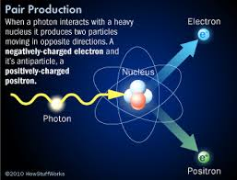

Slide 24
Pair Annihilation
The inverse of pair production occurs when a positron is near an electron and the two come together under the influence of their opposite electric charges. Both particles vanish simultaneously, with the lost mass appearing as energy in the form of two gamma ray photons.

Slide 25
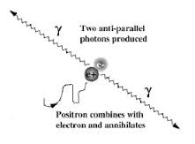

Slide 26
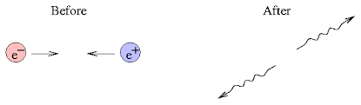

Slide 27
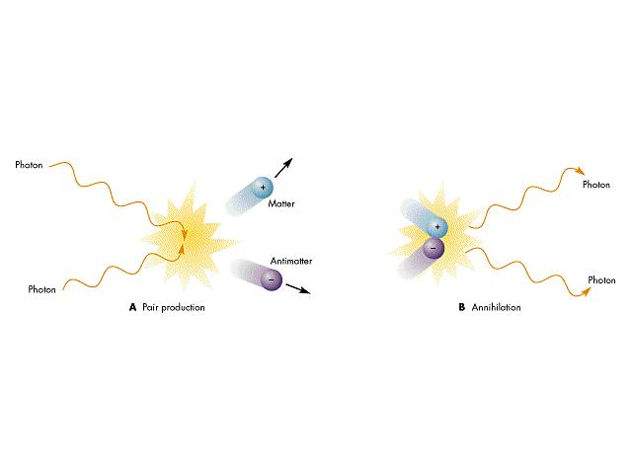

Slide 28
Show that pair production can not take place in empty space.
p
p cos θ
θ
hν/c
θ
p cos θ
p

Slide 29
For conservation of energy
hν = 2 m c²
Here hν is the photon energy and m c² is the total energy of each member of electron-positron pair. Fig. shows a vector diagram of the linear momenta of the photon, electron and positron. The angle θ is equal in order that momentum be conserved in the transverse direction. In the direction of motion of the photon, for momentum to be conserved it must be true that:

Slide 30
hν/c = 2 p cos θ
Or hν = 2 pc cos θ
Since p=mv for electron and positron
hν = 2 mvc cos θ
hν = 2 mc² (v/c)cos θ
Because v/c ˂ 1 and cos θ ≤ 1
hv ˂ 2 mc²

